Slide 1
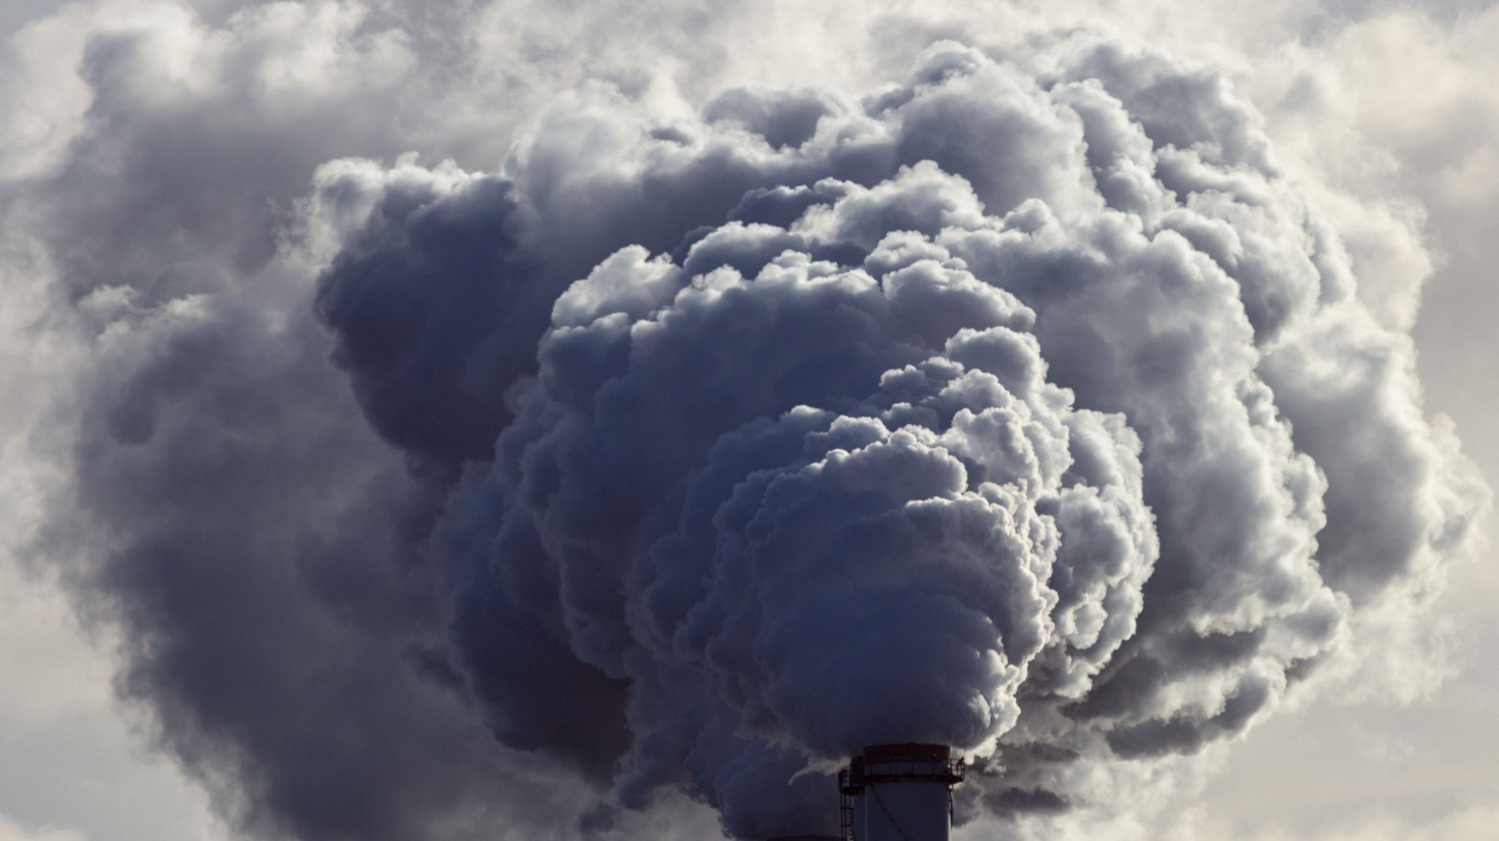
Global Air Pollution Crisis
Group Assignment 1: Group 8
Priya, Sagar, Raviska and Rhiannyn

Slide 2

Introduction: Research Questions and Data
Looking at air pollution and air quality across the world
Are there specific links between carbon emissions and GDP? Has there has been a change for the better/worse, since Co2 emissions and climate change have become more prominent issues?
What effect does air pollution or air quality has on populations? What is the relationship between deaths due to air pollution and the pollutants measured in the API index?
What are the worst polluting countries? What are the countries with the worst API ratings in their capital cities? Is there a relationship between the two?
We found datasets and merged data on countries and population data, deaths due to air pollution data, the air quality index readings and AQI rating using an API request.
The second stage of the analysis required data from a number of years for carbon emissions and GDP, we used a second dataset which includes Co2 emissions and GDP per country per year.

Slide 3
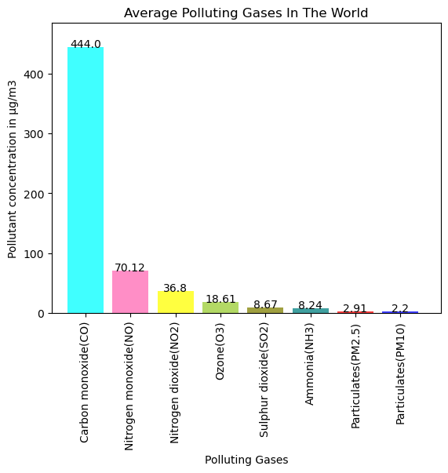
Air pollutants: Air Quality Index and Pollutants other than Co2
1 | 2 | 3 | 4 | 5
Good | Fair | Moderate | Poor | Very Poor
The AQI consists of readings of:
Carbon monoxide (CO), Nitrogen monoxide (NO), Nitrogen dioxide (NO2), Ozone (O3), Sulphur dioxide (SO2), Ammonia (NH3), and particulates (PM2.5 and PM10).
AQI index rating – the worst pollutant rating is taken as the overall rating.

Slide 4
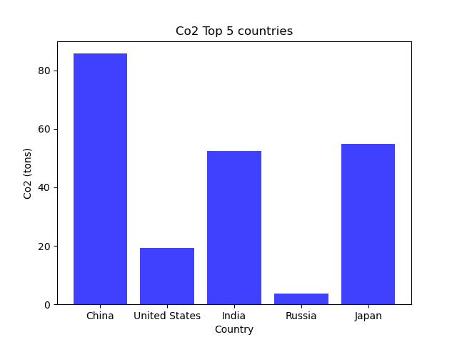
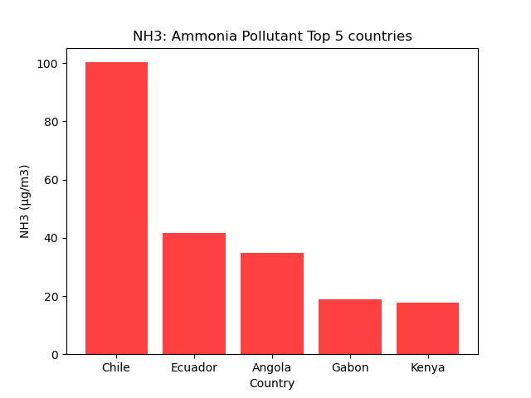
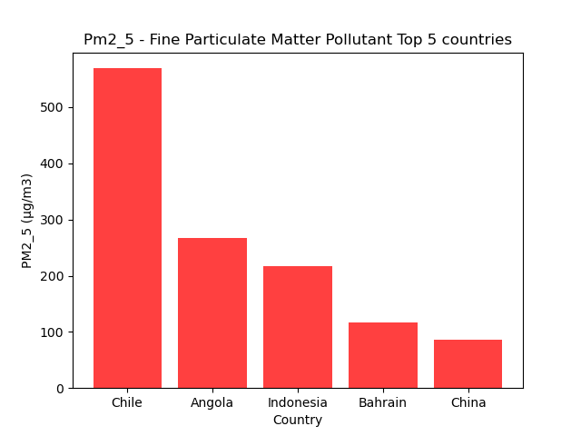
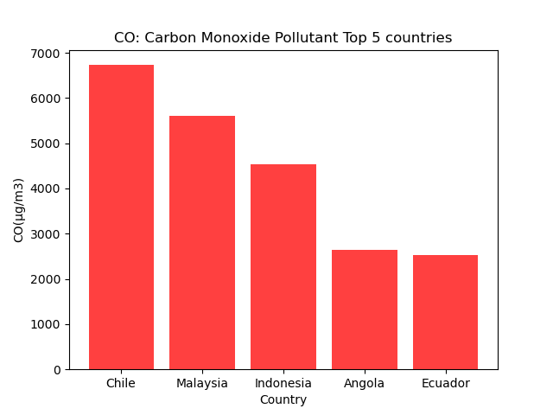
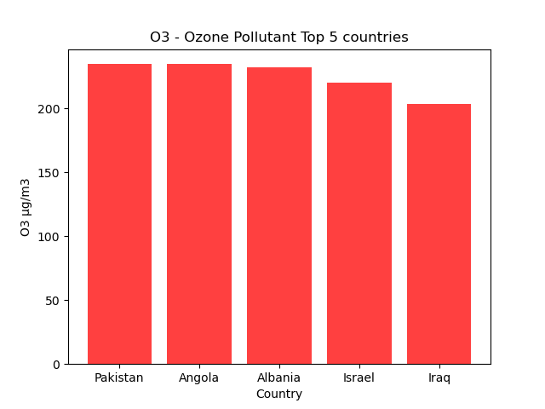
“Top 5” Countries by Pollutants present in their Capital Cities
From the dataset, we can see that the top five polluted capital cities are for countries (other than China) that are not the highest Co2 emission countries.
There is significant difference across the pollutants we measure as significant to human health and that which affects the planet.

Slide 5
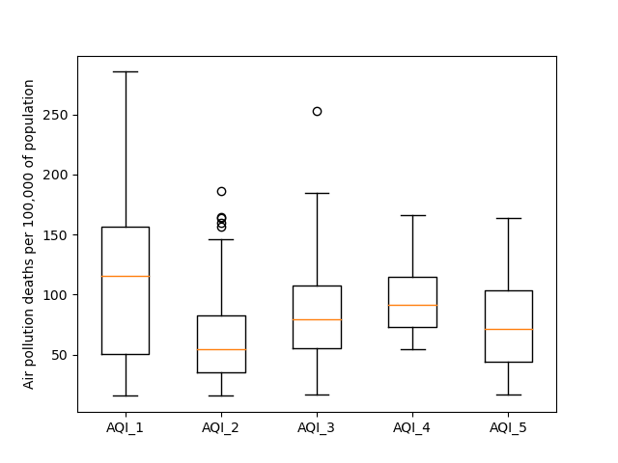
Capital City AQI ratings vs deaths due to air pollution in the population of a country: Is there a statistically relevant link?
Result of ANOVA test over the five AQI groups is less than 0.05 so there is a statistical difference.
But it’s the wrong way around! The best air pollution category has more deaths on average due to air pollution.
Further research and more in-depth data is indicated.

Slide 6
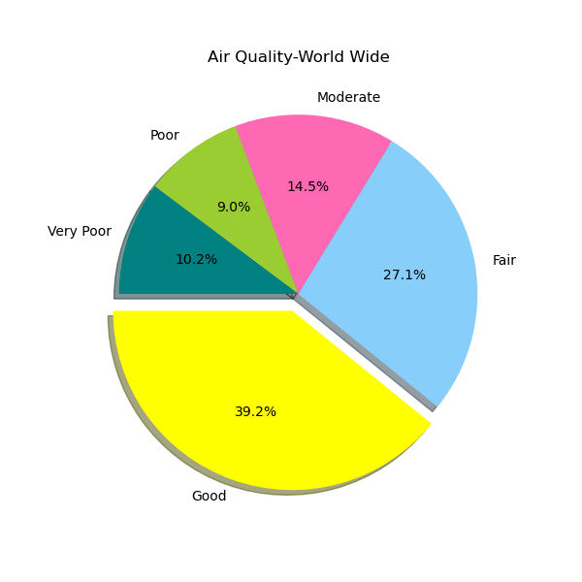
How are countries world-wide rated according to AQI (Air Quality Index)? Air Quality World-Wide

Slide 7
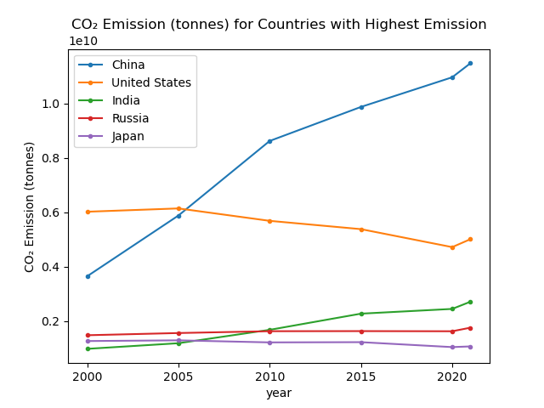
Which countries have the highest and lowest C02 emissions from 2000 to 2021? Countries with Highest c02 Emissions

Slide 8
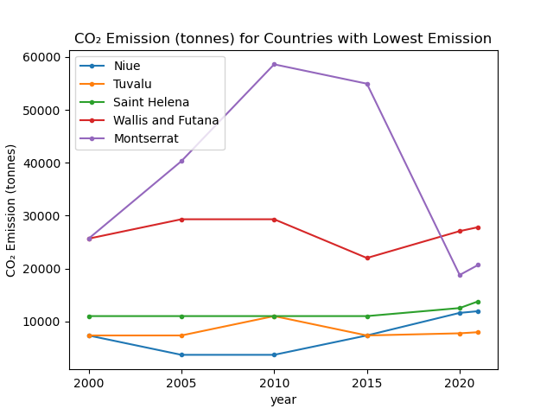
Which countries have the highest and lowest C02 emissions from 2000 to 2021? Countries with Lowest c02 Emissions

Slide 9
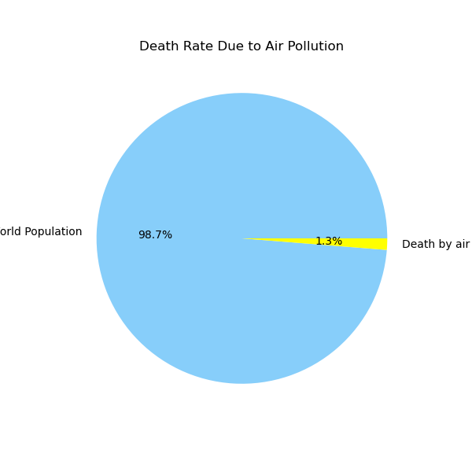
Understanding the link between C02 emissions and the causing impact on death? Death Rate caused by Air Pollution
World Population
Deaths due to air pollution

Slide 10
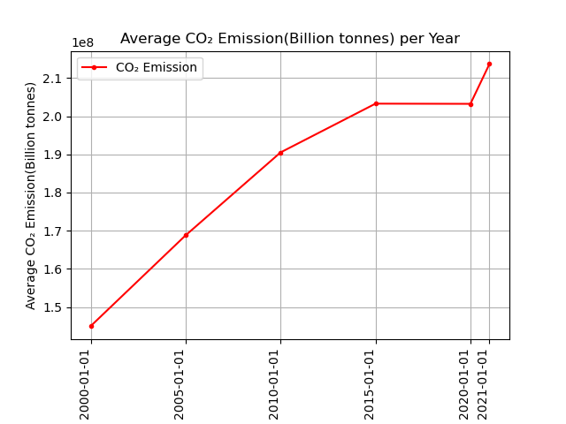
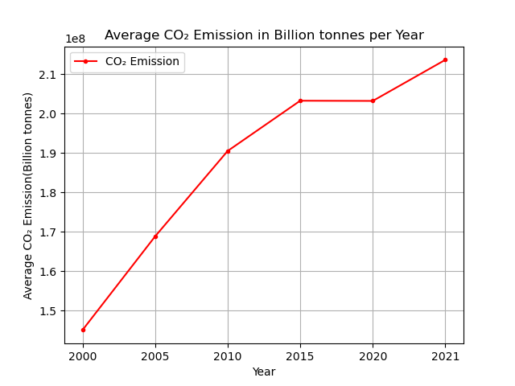
THE CO₂ EMISSIONS TREND BETWEEN 2000 to 2021 AROUND THE WORLD

Slide 11
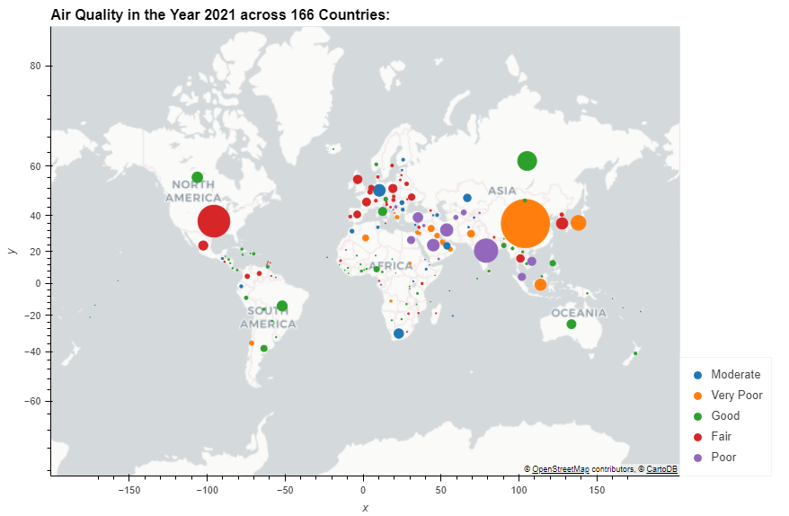
A geospatial visualisation of Air Quality for the year 2021

Slide 12
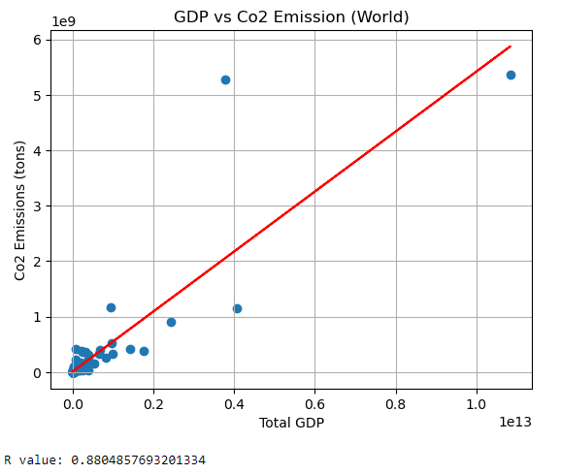
GDP against CO2 emissions: is there a correlation?

Slide 13
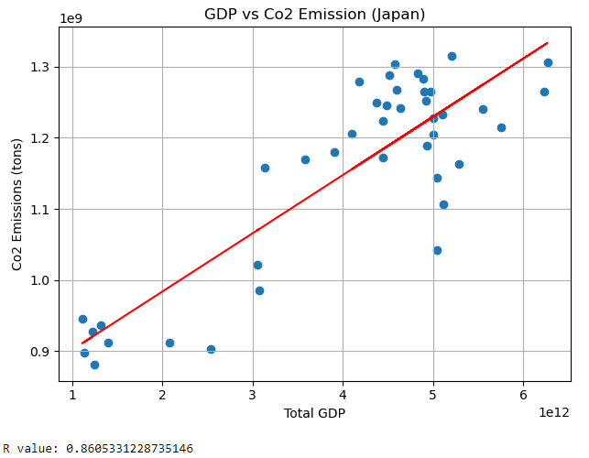
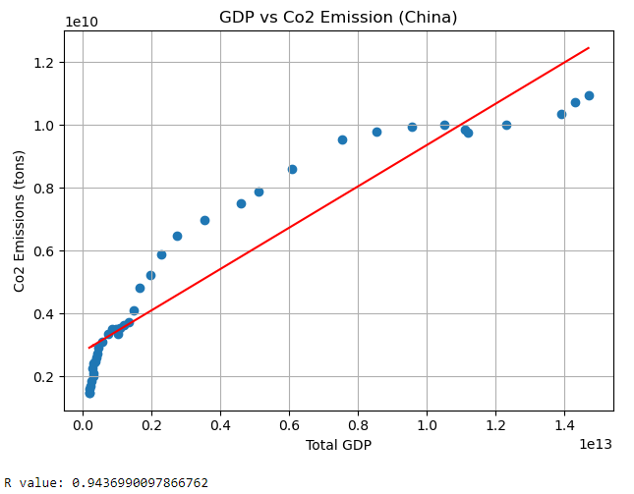
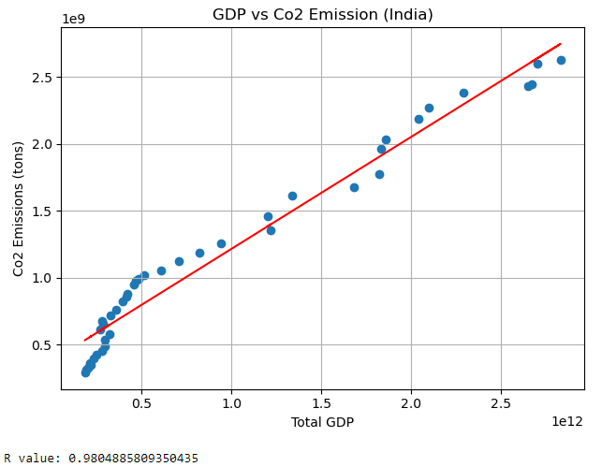
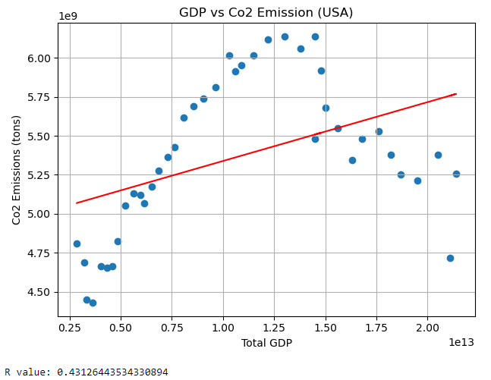
GDP against CO2 emissions: is there a correlation?

Slide 14
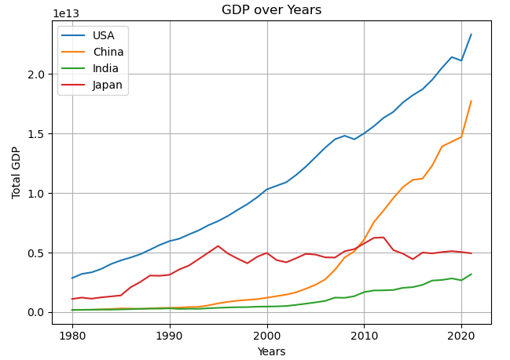
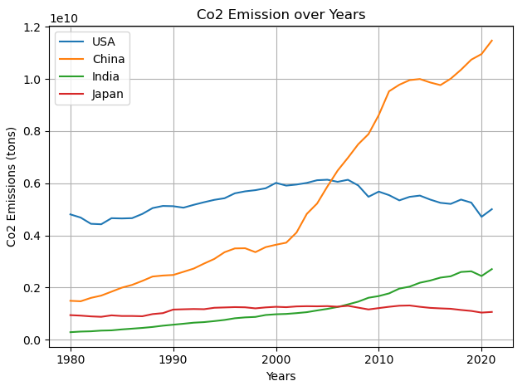
GDP against CO2 emissions: is there a correlation?

Slide 15
GDP against CO2 emissions: is there a correlation? Will a richer economy worsen the environmental quality even further due to increased emissions? The objective of this analysis was to investigate if there is a relationship between economic growth and CO2 emissions. The results for the world data show a positive correlation between the GDP and CO2 emissions. The positive relationship indicates CO2 emissions increase as a result of economic growth. Also, based on the positive slope value, and the correlation coefficient of 0.88, it’s clear that the two variables are linearly related. In further analysis for some of the major countries like USA, China, India and Japan, it can be easily observed that the economic development has affected CO2 emissions. However, for a developed country like USA it’s not the case as there is a decline in the CO2 emissions for the past few years with increasing GDP and one big reason is the use of natural gas and renewables to generate electricity in place of more carbon-intensive fuels. So, it also depends on other factors like, if the country is developed and has a rich economy, they might use more environment friendly resources or if the countries economy is growing due to services rather than manufacturing , it is going to bring down the CO2 emissions over time. So, further analysis can be done keeping all factors into consideration, but this analysis gives and idea that there is a positive relation between GDP and CO2 emissions at least when the country is in the development phase.

